Slide 1
Introduction to Data Science
Daniel Gutierrez, Data Scientist
Los Angeles, Calif.
Notes:
Welcome to the Introduction to Data Science course offered by UCLA Extension.

Slide 2
Course Outcomes
Accessing data sets from R
Review of commonly accessed data sources
Provide reusable code snippets for accessing data
Learn how to write data files
Notes:
This is WEEK 5 of the Introduction to Data Science course offered by UCLA Extension. This module covers data access materials.

Slide 3
Lesson Objectives
Accessing data sources
Downloading files from the web
Comma separated value (CSV)
Excel
JSON
SQL databases
SQL equivalents in R
Writing data
Notes:
The lesson objectives for WEEK 5 are to learn how to access data sets in a variety of commonly use formats and read the data into the R environment in preparation for data munging.
In many cases, a data science project will require accessing data in more than one format from a variety of sources. Once in R, the data scientist can proceed with the data science process and perform data munging, EDA and model selection.
Sometimes, the data access stage is non-trivial because you may need to engage in a discovery process to find applicable data sources. To do this, you may need to interact with enterprise domain experts to determine available and reliable data sources within the organization.

Slide 4
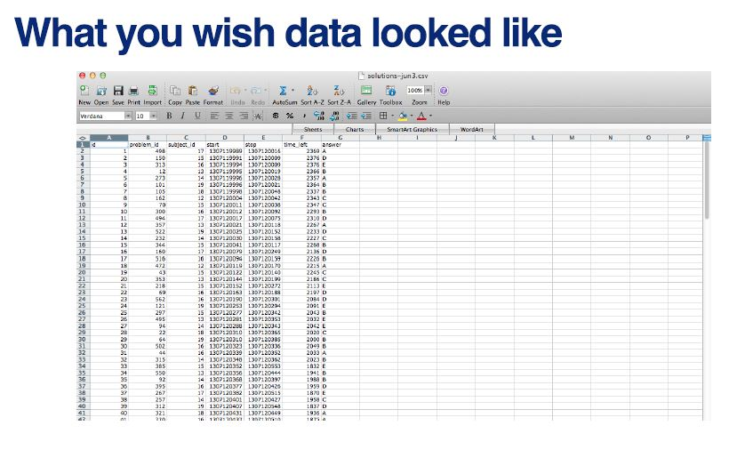
Data Access
Notes:
Here is an example of what a clean data set looks like. This is an Excel spreadsheet consisting of well-defined columns (feature variables) and rows (observations). Notice there are no missing values in the data set. As a data scientist, you’d rejoice if you got a data set like this to work with. Sadly, this often is not the case.

Slide 5
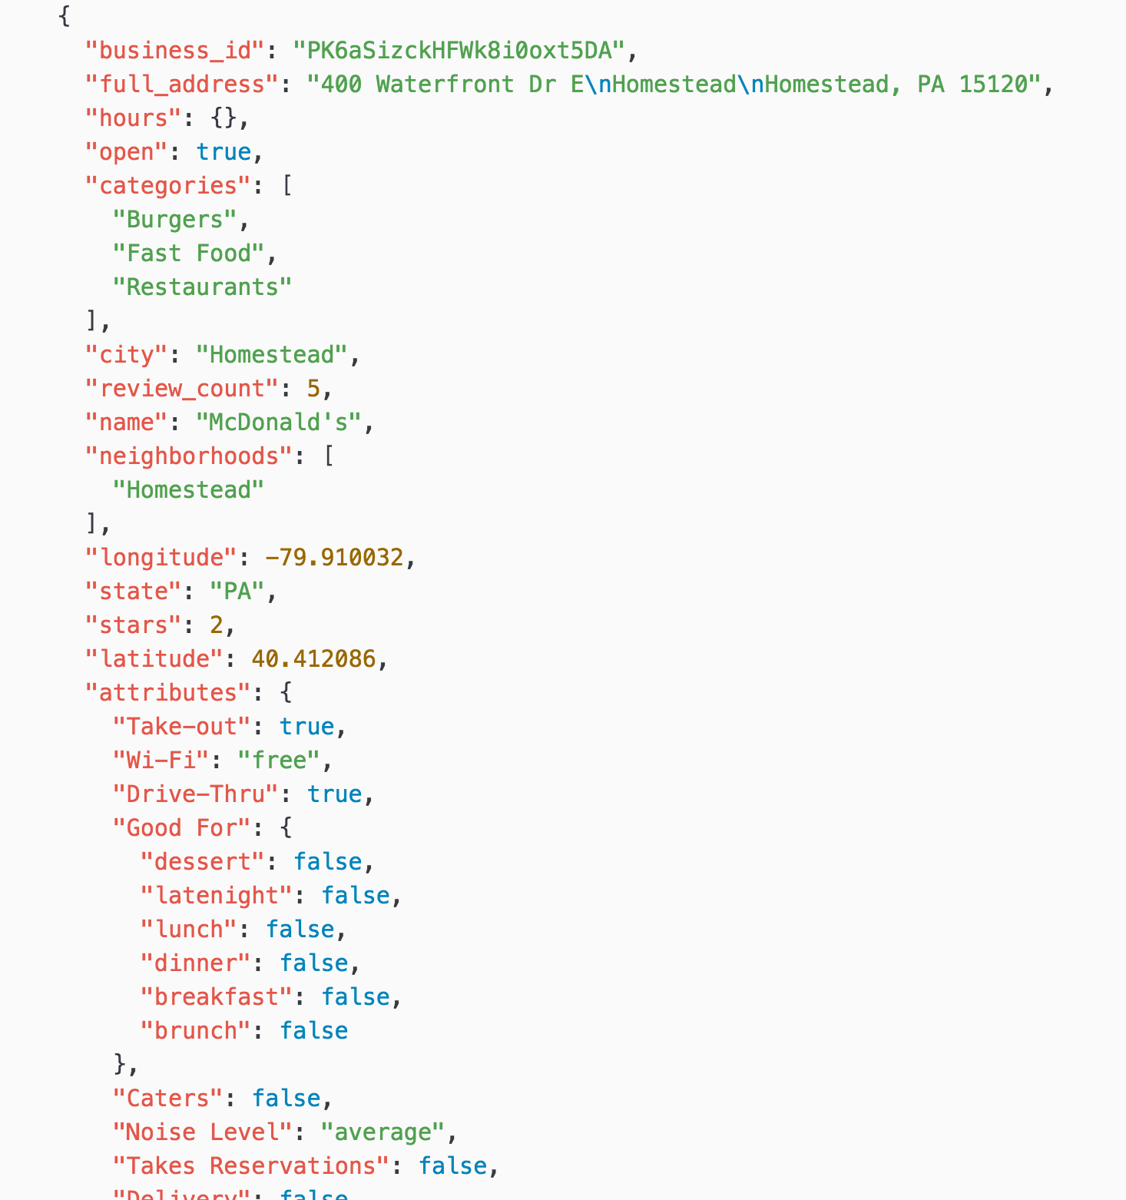
Data Access
Notes:
Here is an example of a popular format JSON. The data set is called ‘Yelp Academic Dataset Business’, which contains information about the businesses listed on Yelp for selected states and provinces in US and Europe. As you can see, JSON data is nested and hierarchical. For example, when you look at ‘categories’ there are three values of “Burgers”, “Fast Food”, and “Restaurants” at the same level. This is called ‘Array’, and it’s useful to have multiple values assigned to one entity like “business” in this case. When you look at “attributes” it has several key-value pairs like ‘“Take-out”: true’ and one of them “Good For” has even its own child level information.

Slide 6
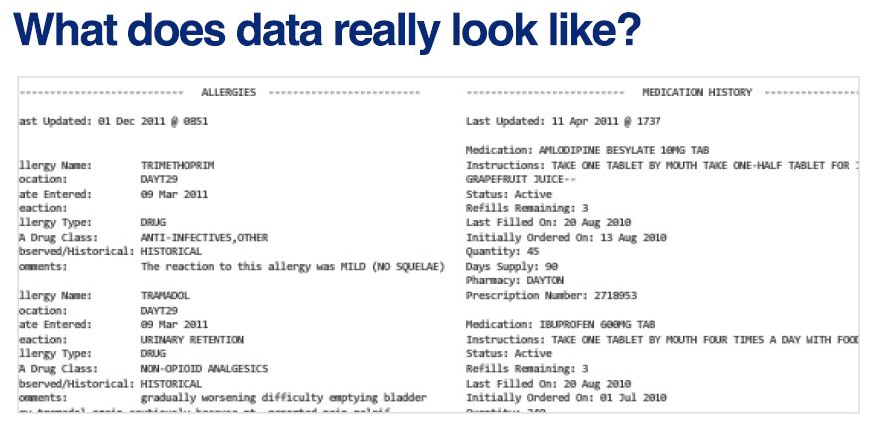
Data Access
Notes:
Here is one example of what data actually looks like in the enterprise environment. In this case, the data is not clearly organized into rows and columns. This means you’ll have to spend a lot of time in the data munging phase of the project to get the data set in the proper format. You may need to enlist the help of a domain expert to help you understand the meaning of each data item.
A domain expert is someone within the organization who has intimate knowledge of the available data resources for a particular application like sales, finance, etc.
You should get in the practice of asking for a data dictionary, although such a valuable resource is not always available.

Slide 7
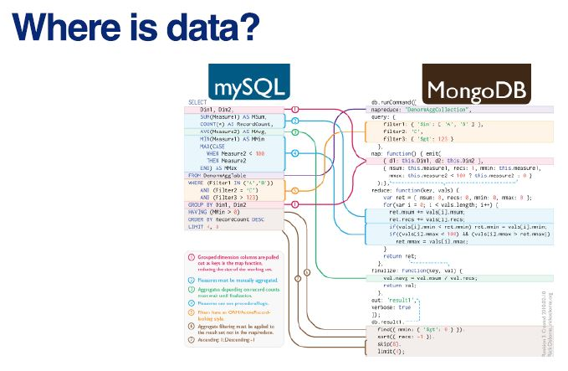
Data Access
Notes:
In the modern enterprise, data is often found in a relational database, data warehouse, or data mart. You may need to work with an IT specialist to write ETL code in the form of a SQL stored procedure to extract the data and write a CSV file for use with the data science project.
Alternately, if you’re given access to these repositories, you can access them directly from within R using SQL.

Slide 8
Where Can You Find Data
You’re given data from enterprise stakeholders: enterprise relational SQL databases, data marts, data warehouses, data lakes
Data repositories like: UCI ML Repository, data.world open data
Data search engine: Google Dataset Search
Government data repositories: data.gov, data.lacity.org
Social media
Scraping web sites
APIs

Slide 9
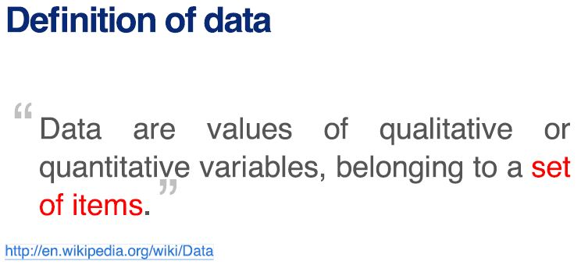
Data Access
Set of items – sometimes called the population; the set of objects you are interested in
Variables – a measurement or characteristic of an item
Qualitative item – country of origin, gender, department, etc.
Quantitative item – Q1 sales, salary, square feet, etc.
Notes:
Here is a simplistic definition of “data” from Wikipedia.

Slide 10
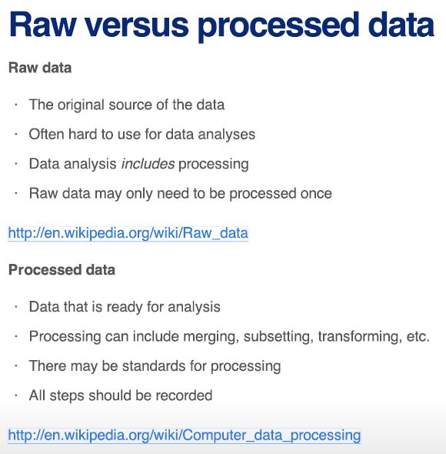
Data Access
Notes:
Let’s talk about the difference between raw and processed data. To do this, we’ll consider a few points provided by Wikipedia.
In the case of raw data, it is considered the original source of the data. One characteristic of raw data is that it is often hard to use for data science purposes. Remember, data science includes processing.
Raw data may only need to be processed once, however, in the case of data sets that are continually updated, you may need to create a data pipeline to re-acquire and re-process the raw data at regular intervals like monthly, quarterly, annually.
As for processed data, this is data that’s ready for data science. Processing can include merging, subsetting, transforming, etc. There may be specific standards for processing depending on the application. Finally, all processing steps should be fully documented.

Slide 11
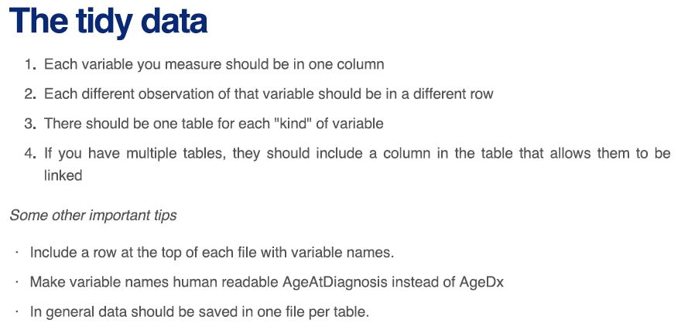
Data Access

Slide 12
Code module
WEEK 5-1 Code module – downloading files
WEEK 5-2 Code module – reading CSV and Excel
WEEK 5-3 Code module – SQL databases
WEEK 5-4 Code module – SQL equivalents in R
WEEK 5-5 Code module – writing data files
Notes:
In order to demonstrate the concepts for WEEK 5, we’ll step through a series of in-depth R code examples found in the Code modules listed.
I encourage you to take the R script file for WEEK 5 and try each code snippet yourself. Take some time to tweak each example and try different things so you’ll fully understand each programming concept.

Slide 13
Summary
In WEEK 5 of Introduction to Data Science we continue to add useful items to our data science toolbox. This time, we added tools to access different data sources
We saw how to download files from the web
We read in files in CSV and Excel format
We read in files in JSON format
We read in data from a SQL database
We saw how to do SQL equivalents using R
We wrote a new data file
Notes:
In WEEK 5 of Introduction to Data Science we continued to build up our data science toolbox by adding some valuable tools for working on data science projects.
Specifically, we saw how to download files from the web using a URL with the download.file() function
Once the data set is on your local machine, we were able to read files in CSV, Excel and JSON format. These formats are the most common ones you’ll deal with, as most data sets are available in one of these formats.
We also saw how you can treat a web page as a data source using a technique called “web page scraping.” This is a powerful technique since the web is full of data.
Next, we saw how to read data directly from a SQL database, and also how to use SQL equivalents in R, that is, R commands that can function like SQL statements.
Finally, we were able to write a new file onto disk containing data from R.

